Slide 1
Test_Phylo
Kyle Johnson

Slide 2
Tables SARs

Slide 3
Inbitial Thoughts Slide
Originally did by the following:
Parasites, Photosynthetic symbiotes, Ciliates
Found some out-lier organisms which are unicellular
In Stramenopiles, fairly uniform distribution of TOR Components
Rhizaria information is unreliable at current moment
Alveolata contained wide majority of parastic organisms

Slide 4
Continued Work
Expanded research parameters to include the following:
For Archaeplastida: Streptophyta, chlorophyta, rhodophyta
For Excavata: Discoba and Metamonada
Currently looking for more information about Rhizaria
Beginning SRA work to rule out/in some outlier species in all supergroups
Expanding the phylogenetic trees for the protein components

Slide 5
RICTOR Results
RICTOR very prevalent across the different Super Groups
Found especially within the Excavates and the SAR Groups
Some hits were found in the Archaeplastida grouping
SRA analysis required to officially confirm presence
Possible issues with contamination in Streptophyta specifically

Slide 6
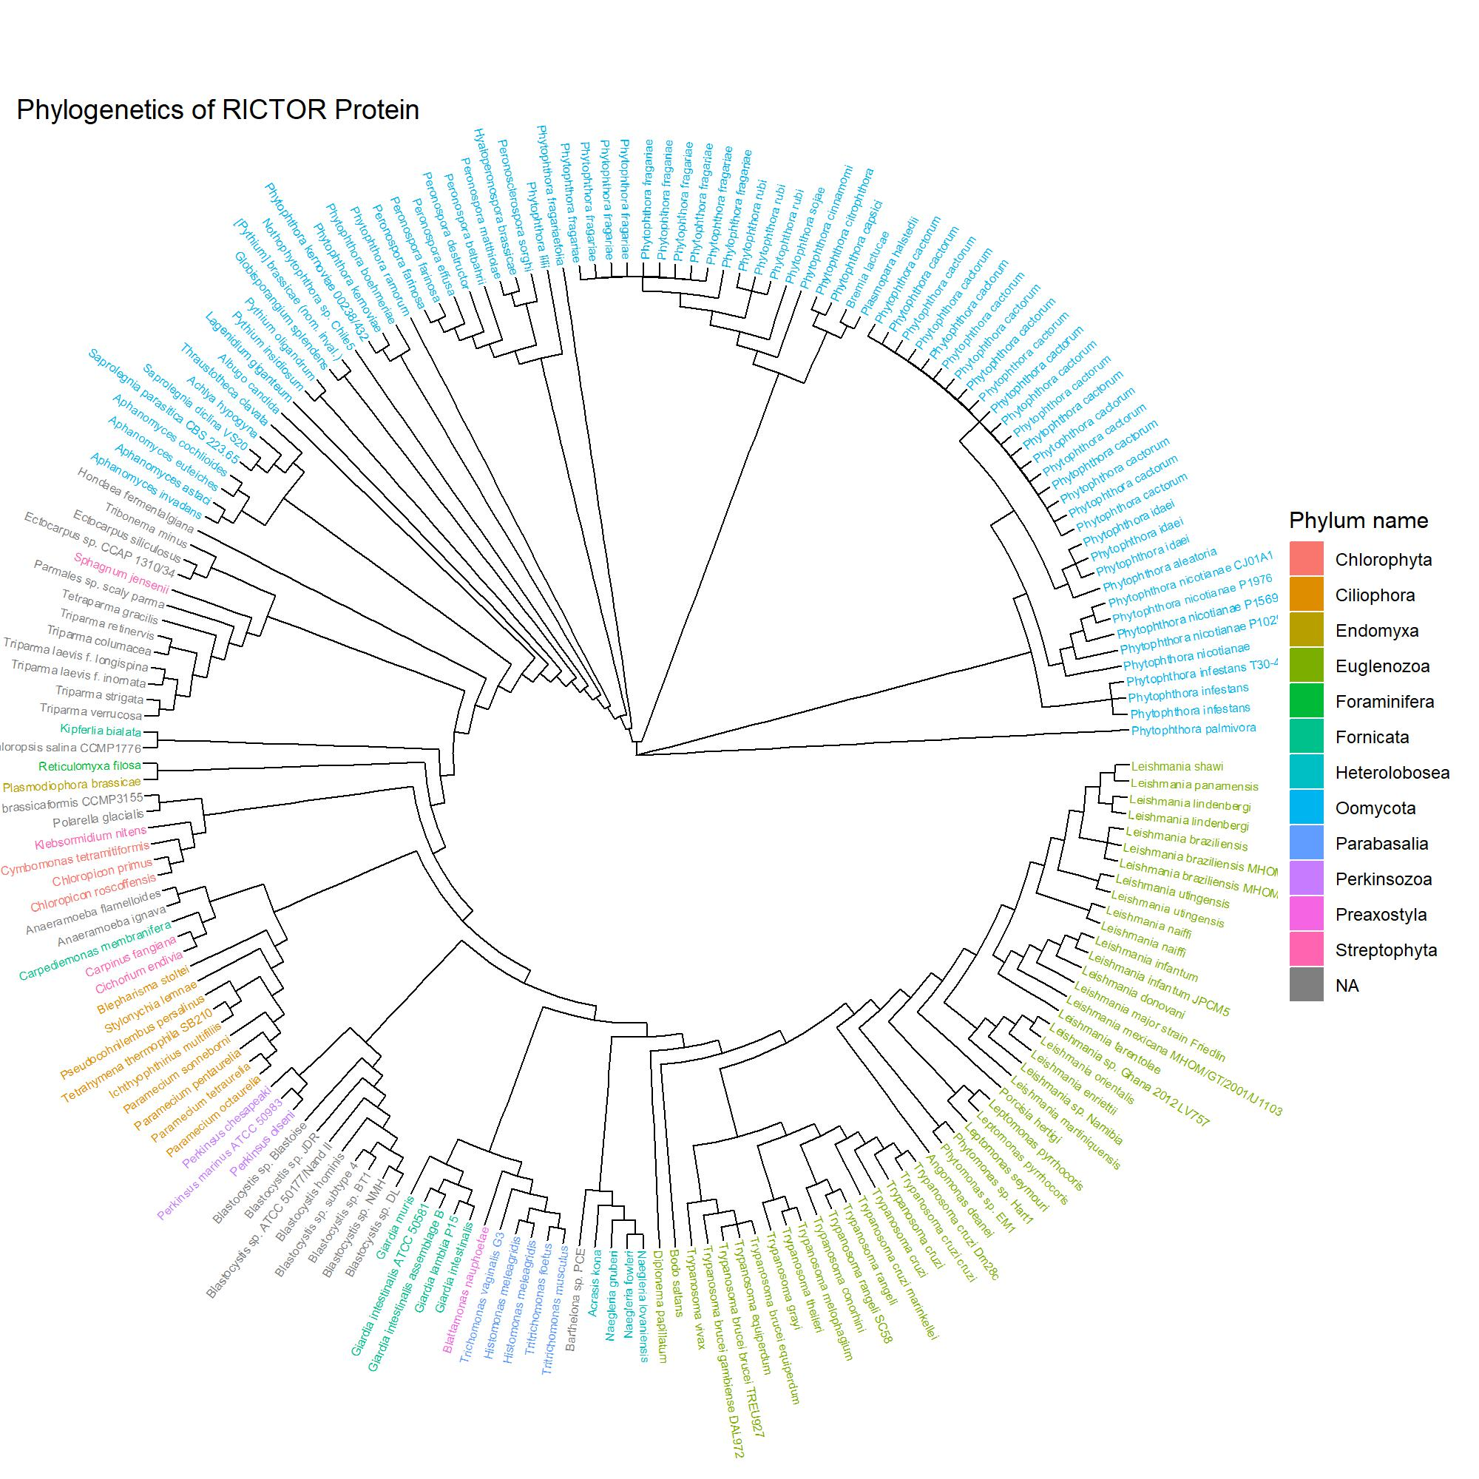
Combined Rictor Tree

Slide 7
## RICTOR Values Plot

Slide 8
SIN1 Results
SIN1 much more rare in most Super Groups
Predominately in the Oomycota group (Pseudo-Fungi)
Very Prevalent within the Ciliates
Some random hits detected in Chlorophyta and Streptophyta
Further SRA analysis required to rule out their presence

Slide 9
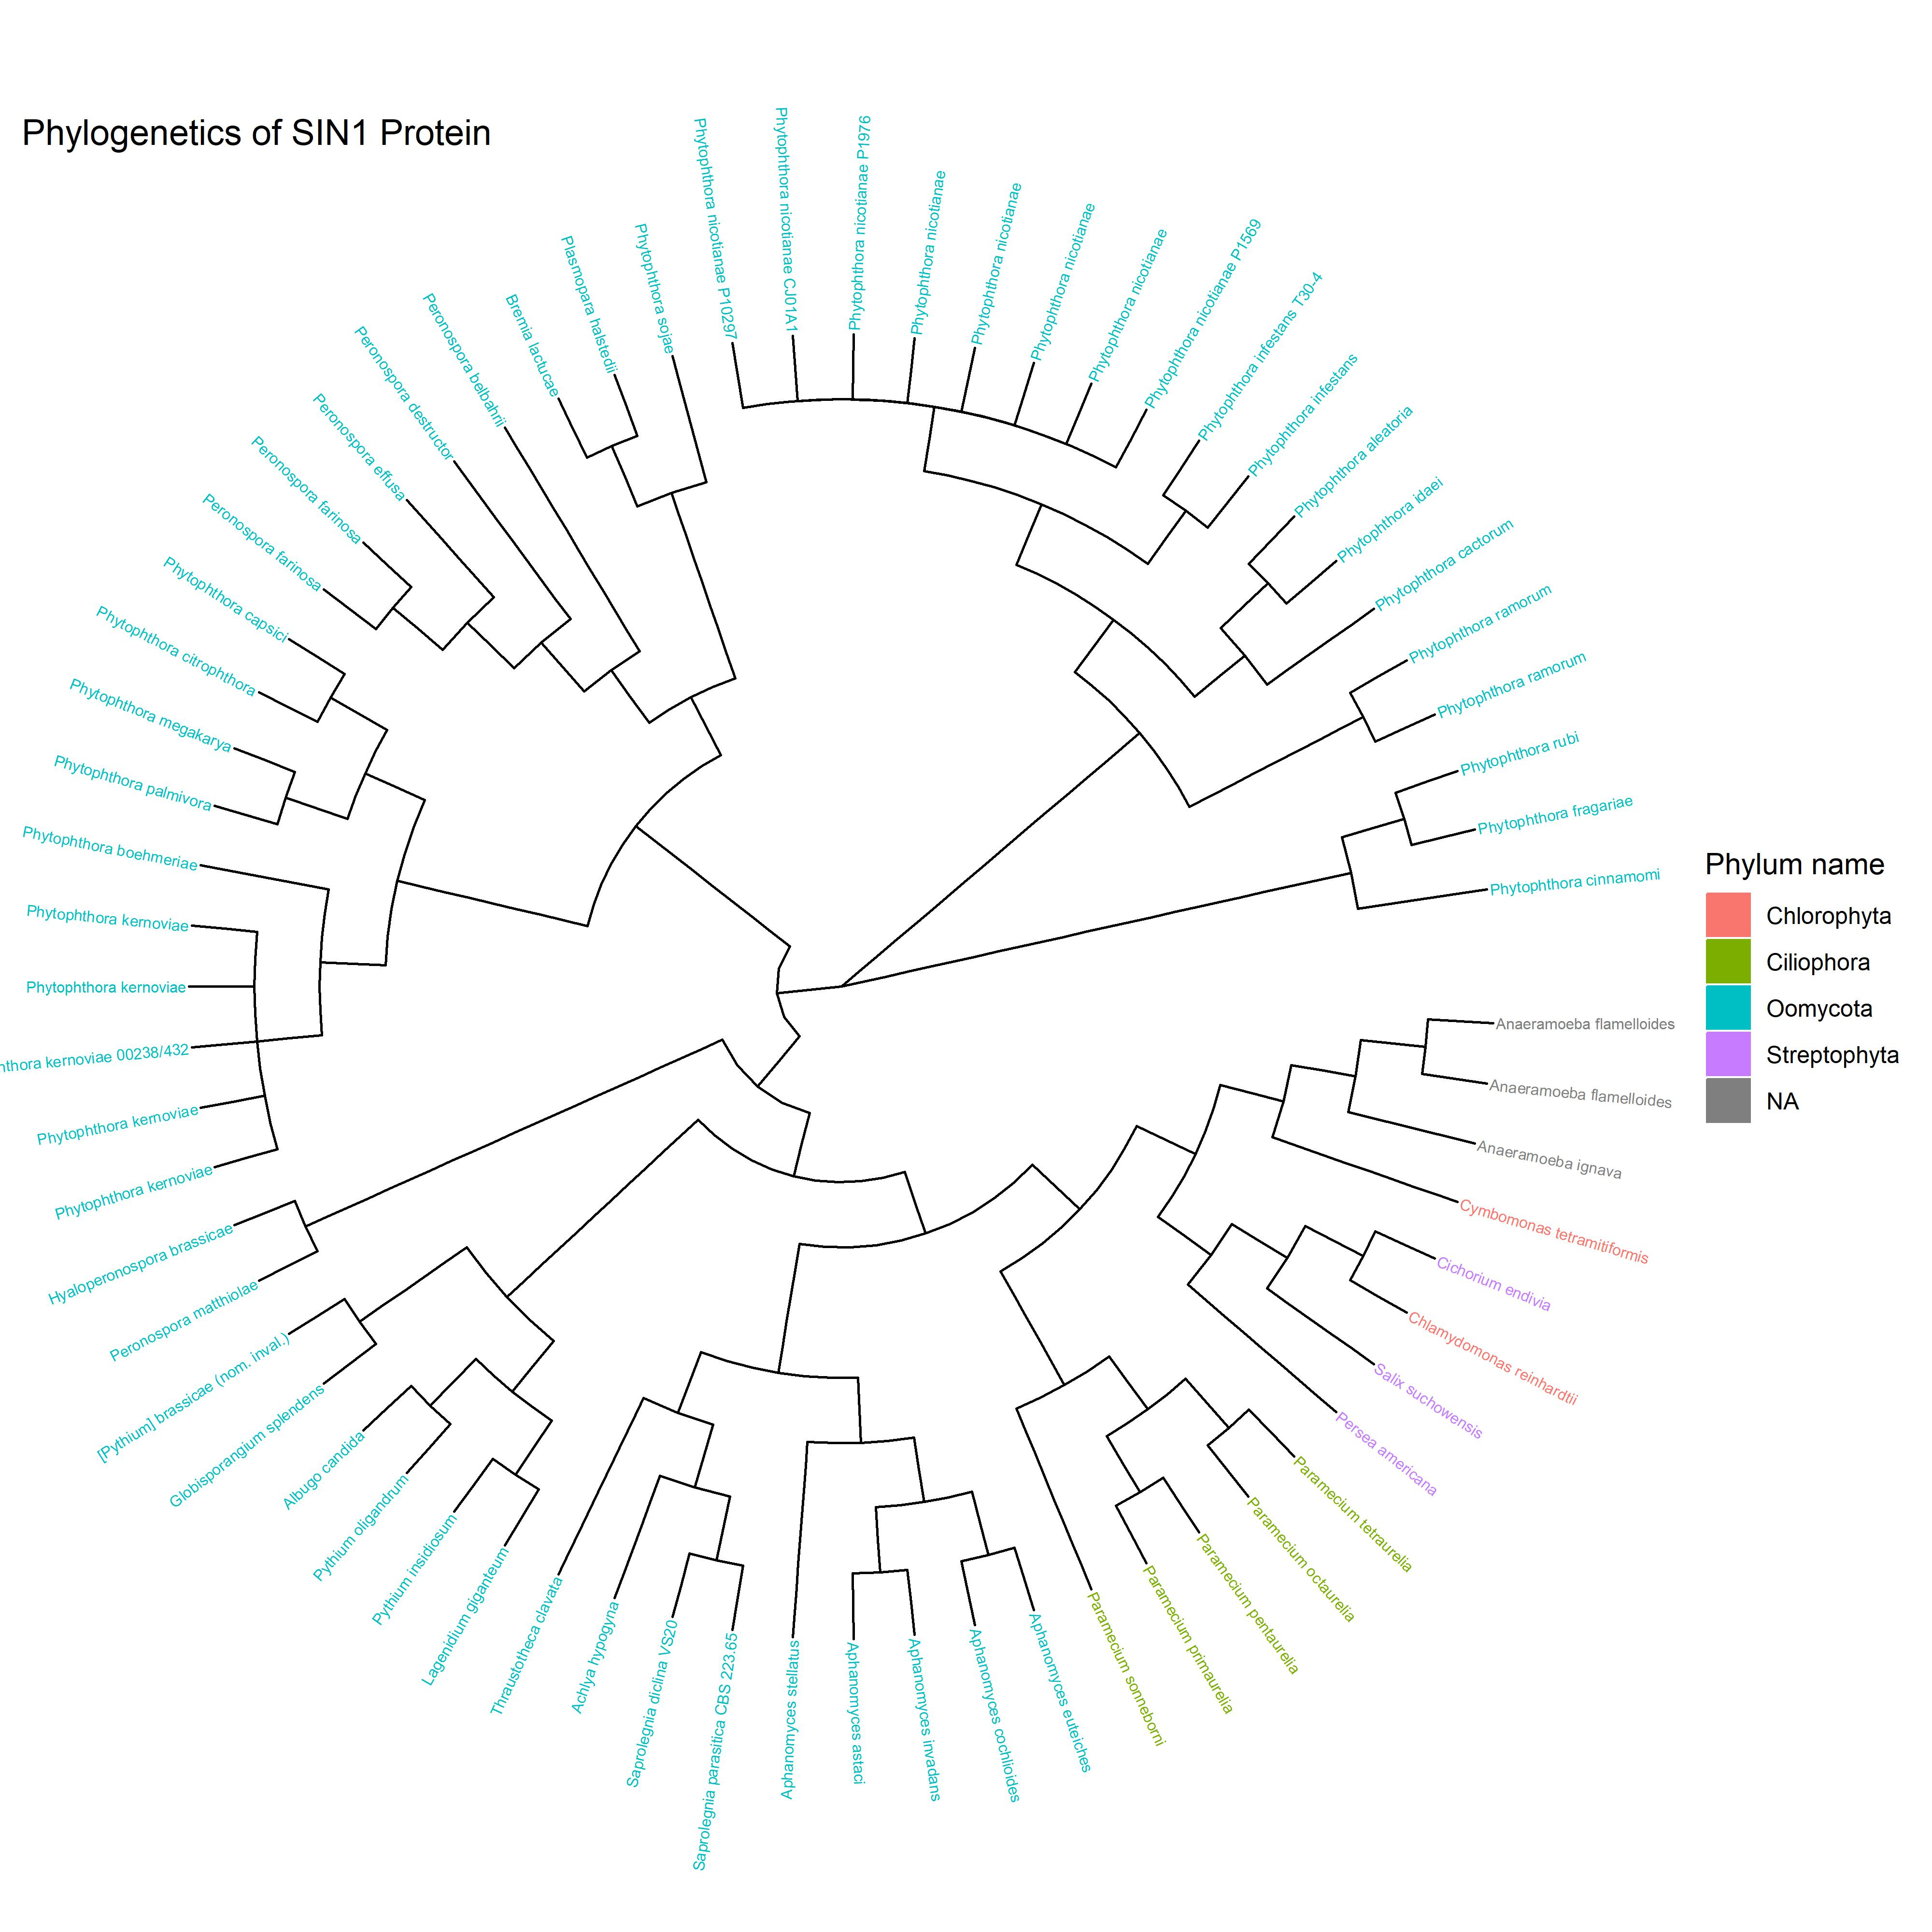
Combined SIN1 Tree

Slide 10
RAPTOR Results
RAPTOR found across all Super Groups
Major exception found within the Ciliates who lack entirely
Results indicate the presence of One RAPTOR at minimum. More likely (see A.thaliana)
Very clustered results. I.E. RAPTOR proteins tend to stay very close to Group

Slide 11
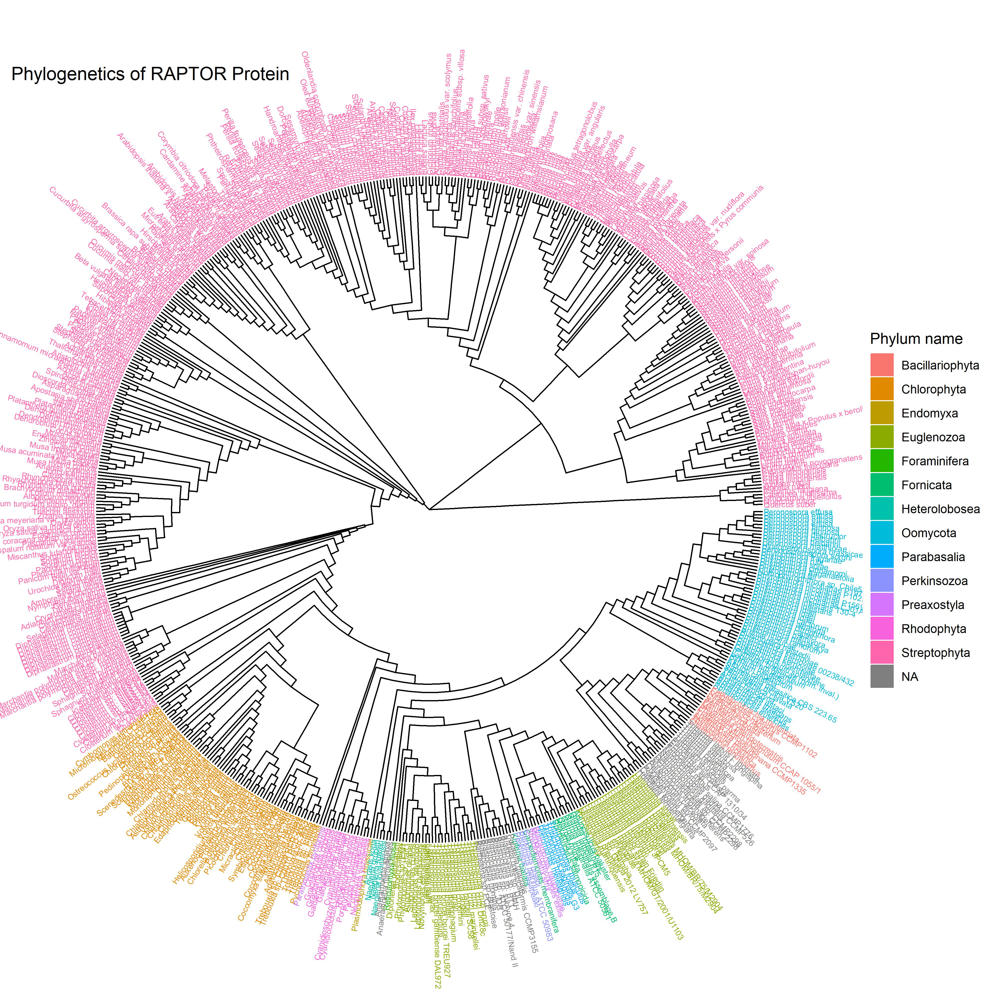
Combined RAPTOR Tree

Slide 12
TOR Results
TOR found across nearly every single species sampled
Orgininally thought that all parasites lacked TOR, results suggest some remnant
Very strong clustering into Group

Slide 13
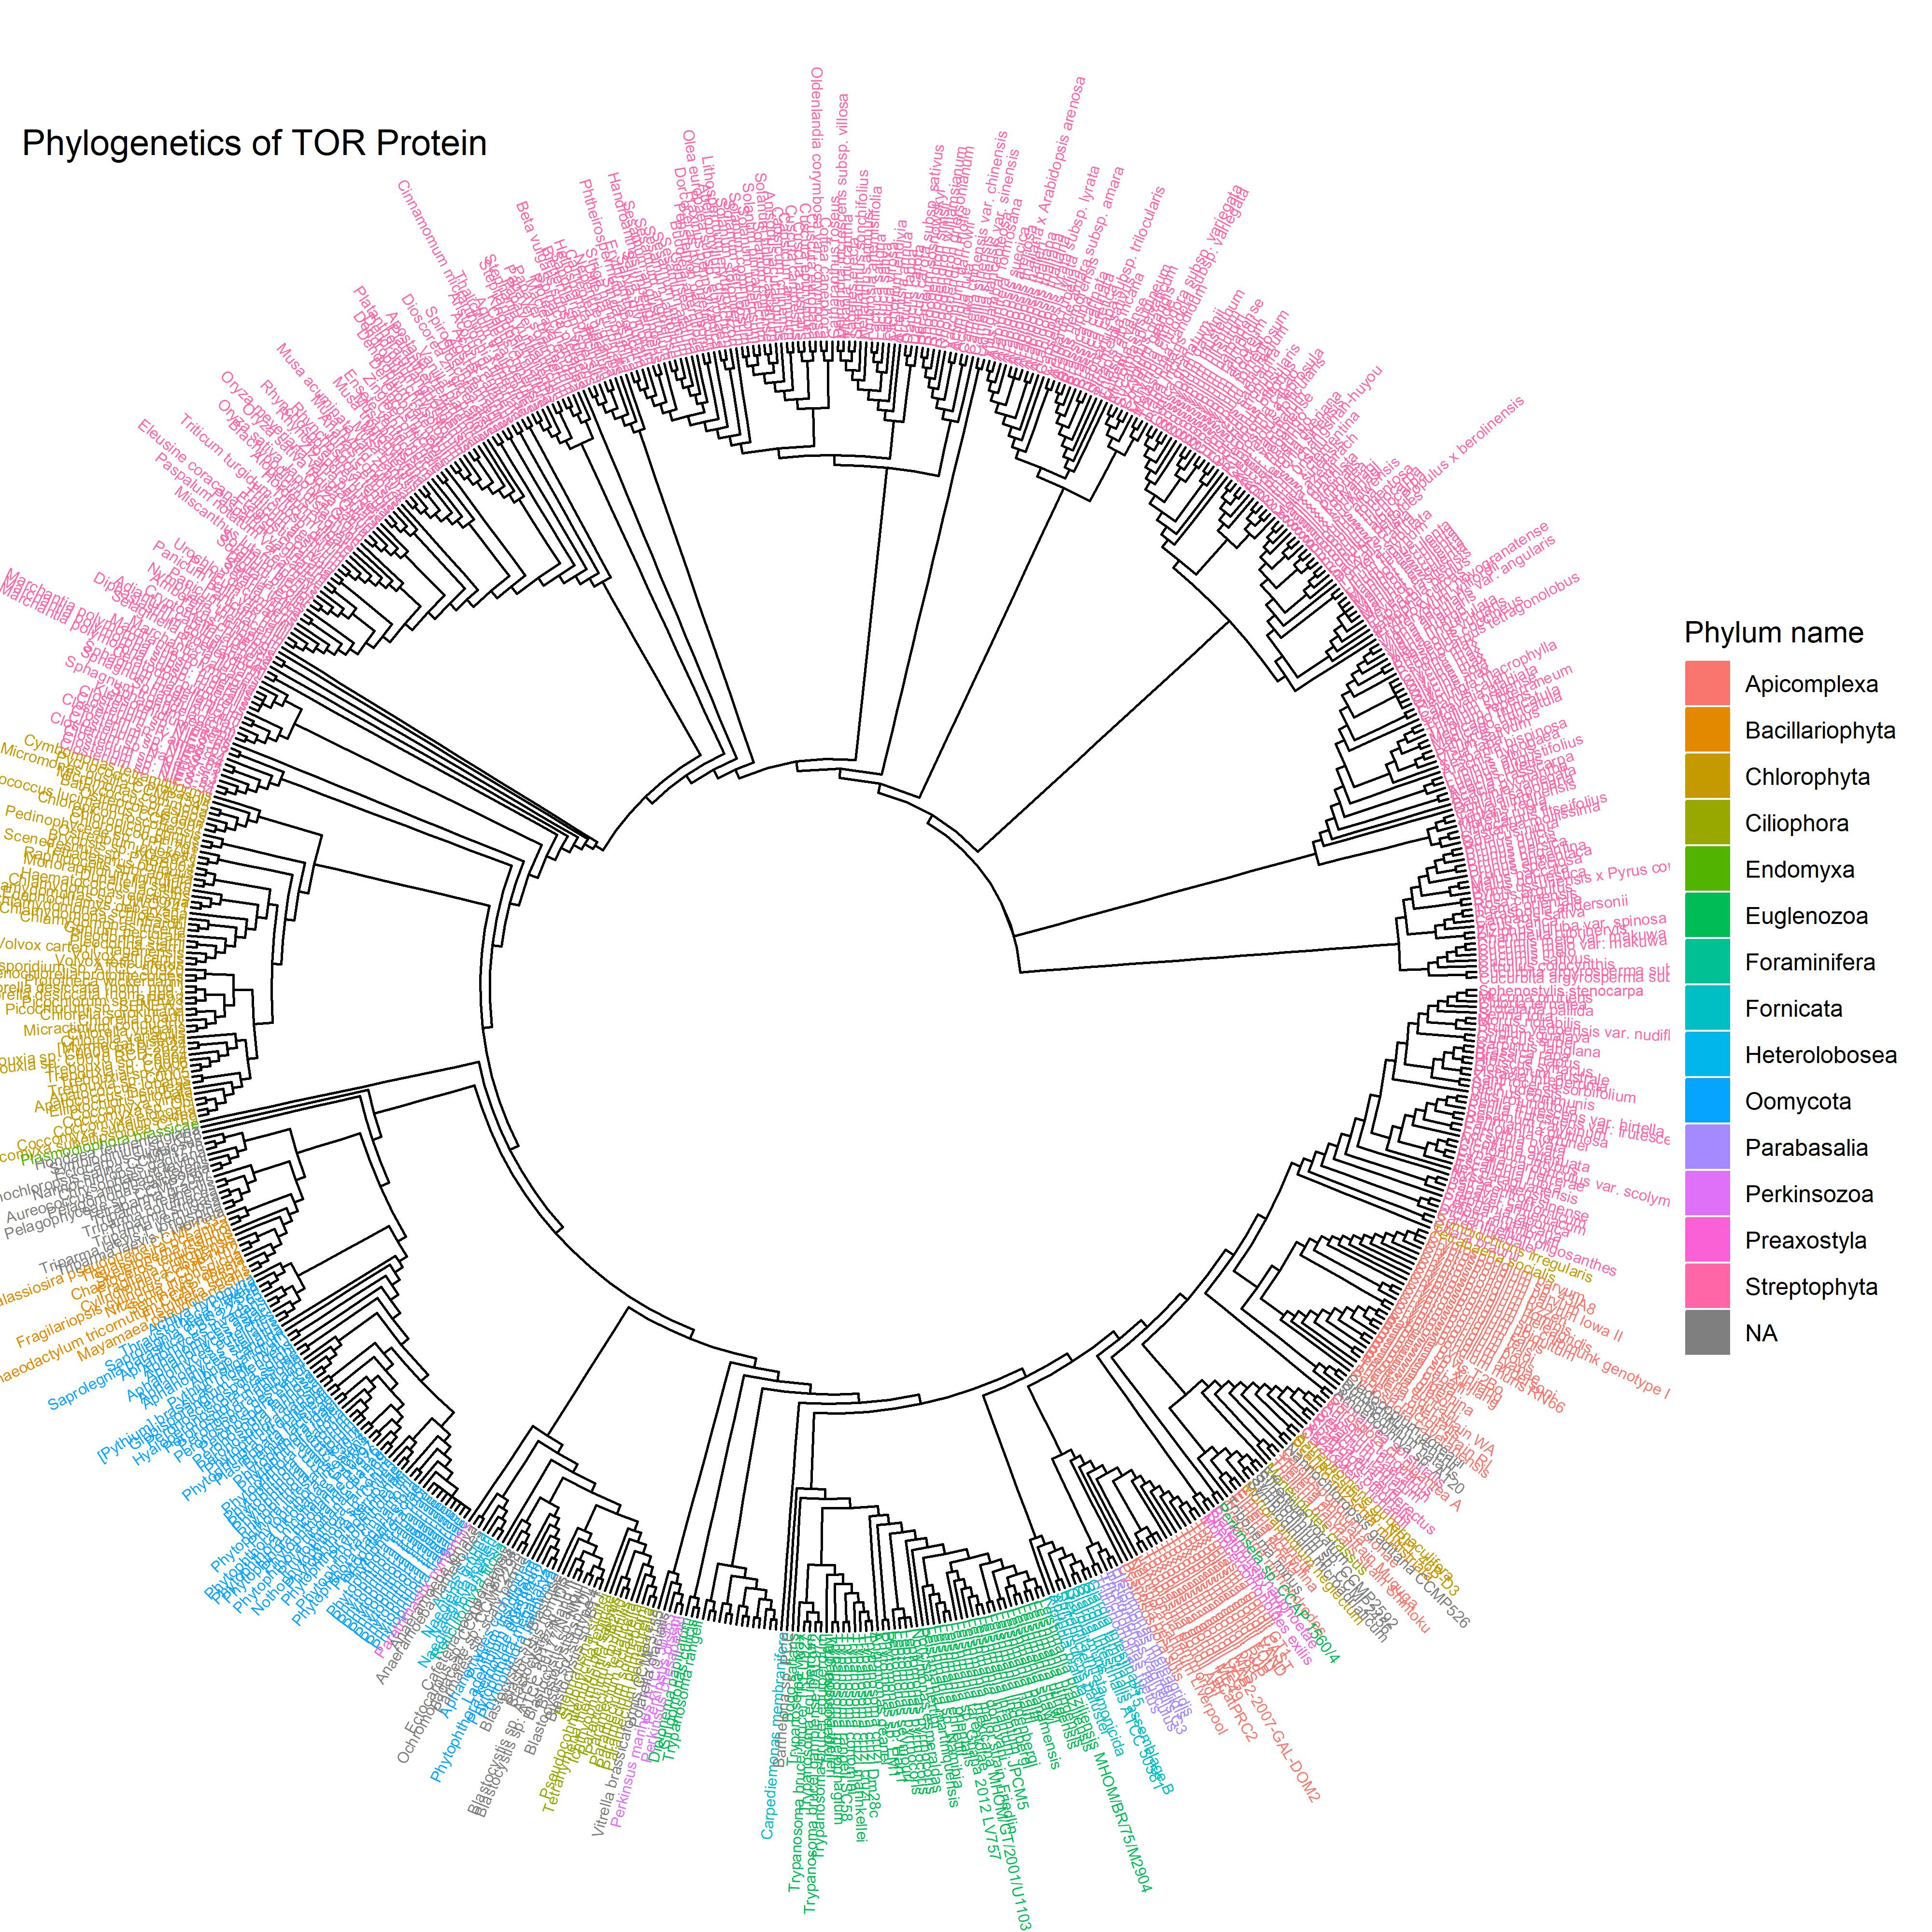
Combined TOR Tree

Slide 14
LST8 Results

Slide 15
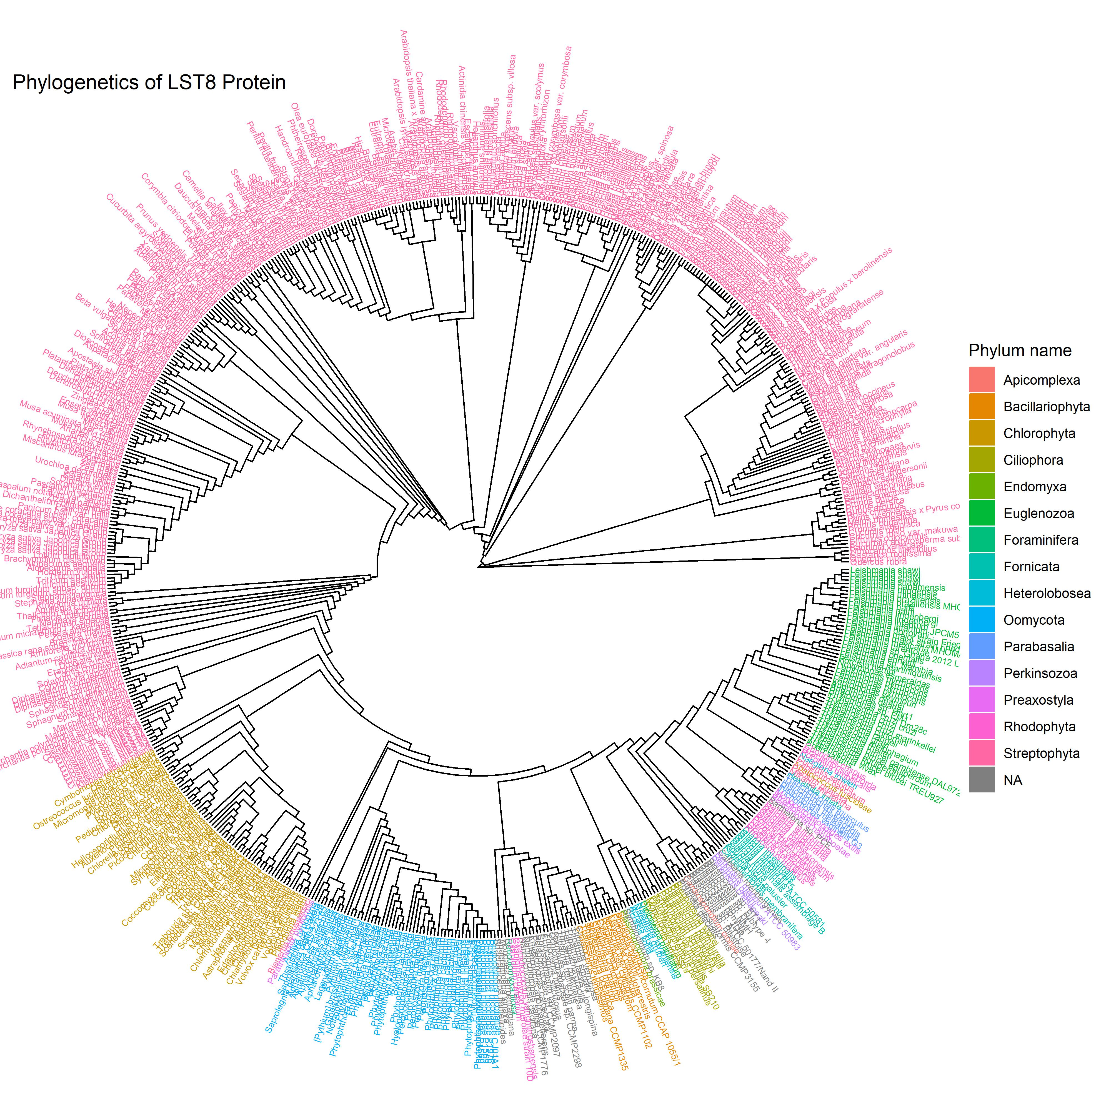
Combined LST8 Tree

